Slide 1
Project Presentation: Rewrite GildedRose
Erdem Sevilmis, Gabriel Wiedermann, Julian Haderlein

Slide 2
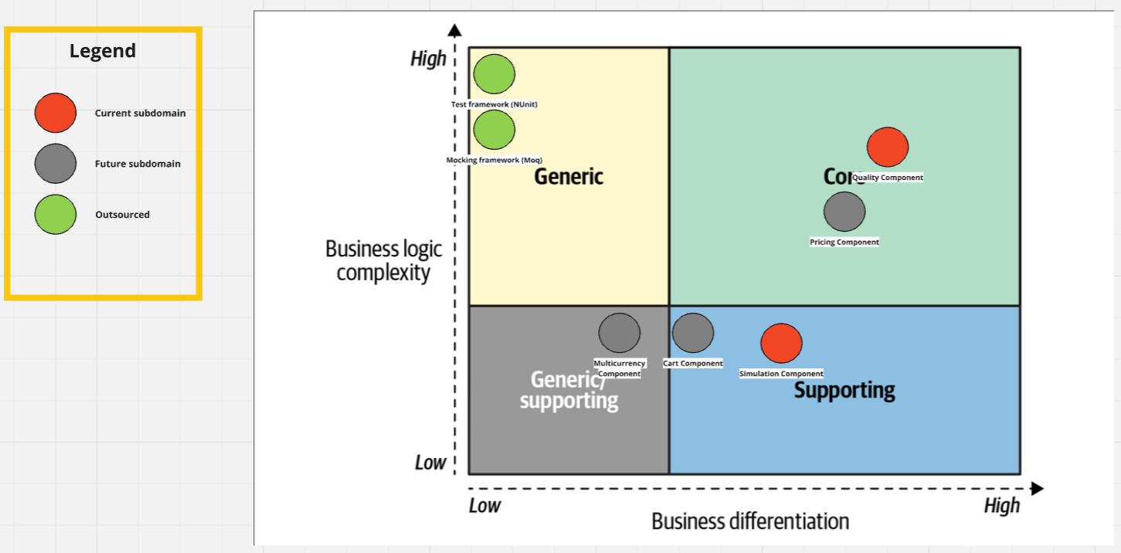
Core Domain Chart (bezogen auf die Applikation)

Slide 3
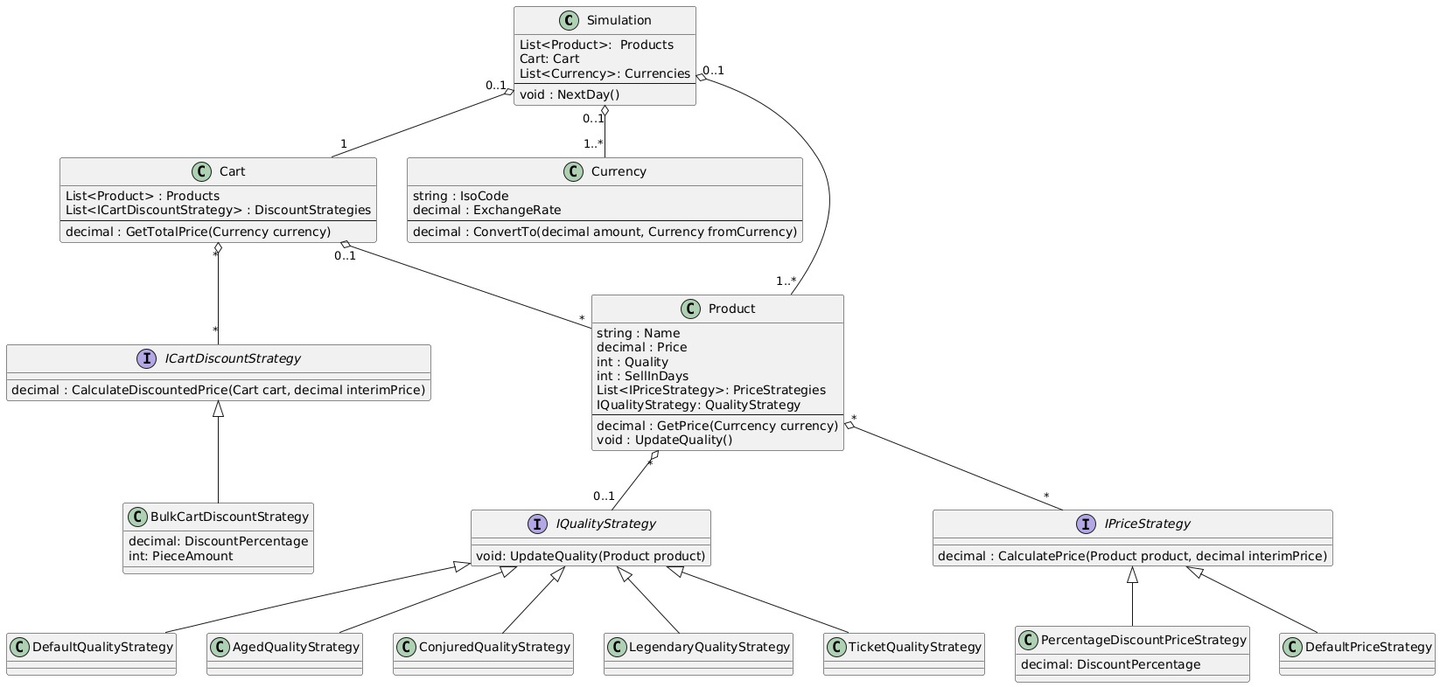
Solution Design (Class Diagram)

Slide 4
Benefits of our solution
Easily extendable
Allows for combination of complex Pricing calculation strategies
Follows the single responsibility principle (easier to maintain and test)
Open for extension, closed for modification

Slide 5
Link to Github
https://github.com/helloplayer1/GildedRose

